Slide 1
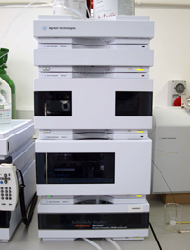
Determination of metformin in urine (by Liquid Chromatography LC)
Eva troja leonard deda Gëzim boçari
Prizren, September 2014

Slide 2
Determination of metformin in biological fluids
(human plasma, urine, etc)
Challenge to conventional chromatographic methods

Slide 3
Metformin
Oral antidiabetic drug
Small molecule with high polarity
(impossible to maintain by RP columns)
pKa1=2.8 and pKa2=11.5

Slide 4
Determination of Metformin in urine
There are many methods to determine Metformin in urine :
Capillary electrophoresis (with contactless conductivity dedection)
Voltammetric method
Cation-exchange HPLC
Normal phase chromatography
LC-MS
RP-HPLC (specific column or common columns using ion-pairing agent)

Slide 5
The purpose of the study
To developed a method using a conventional column

Slide 6
Ion-pairing chromatography

Slide 7
The problem of biological sample preparation
Extraction is necessary because:
Provides a purity of biological material to be injected
Enables analyte’s concentration
Solid phase extraction:
It is costly ( C18 column ion - pairing or dedicated column)
Liquid-liquid extraction :
It is difficult
Limit of quantification ( 1.6 mcg/mL )
Use small amounts of biological matrix

Slide 8
What do we want from our method ?
To be simple
To use conventional column
To be selective
To be accurate
To be rapid
To comply the purpose (study of BE from urinary data)

Slide 9
Materials and reagents
Metformin HCl
ACN (HPLC grade)
SDS, H3PO4 (analytical grade)
Millipore water (Direct Q-UV-Ultrapure® water system)
NYLON membrane filters type HNWP (47mm, 0.45µm)
Varian Scientific Syringe filters PTFE (17 mm., 0.22µm)

Slide 10
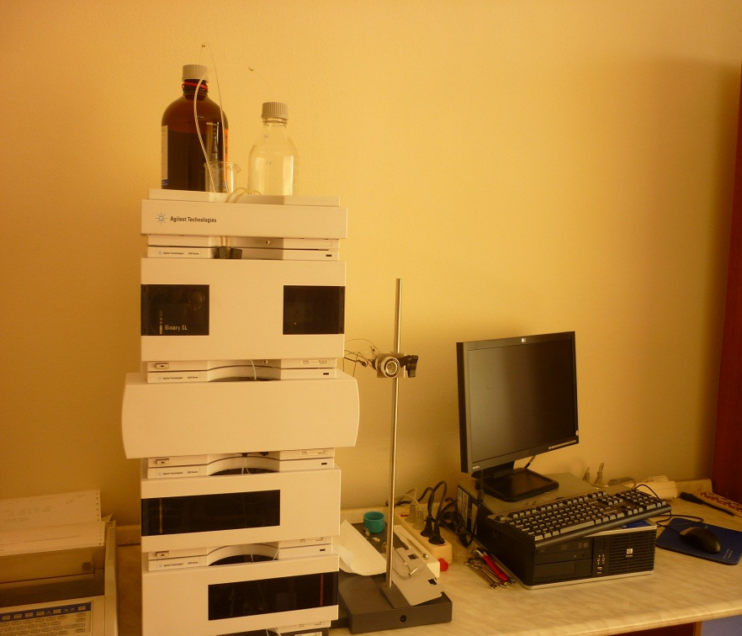
Instruments/Chromatographic system
Chromatographic system in reverse phase Agilent 1200, having in-built binary pump, UV/Vis DAD (Agilent 1200) using CWS software (ChemStation) install in PC.
Superspher® 100 RP 18 (250mm x 4.0mm i.d., 5µm particle size) C18.
Centrifuge
Analytical balance
Vortex
pH-meter
Ultrasonic cleaner

Slide 11
Chromatographic conditions
Mobile phase ACN:sodium phosphate buffer 10 mmol pH=6.0, 0.3%SDS (30:70)
Mobile phase was filtered and degased for 30 minutes before use.
The flow rate 1.00 ml/min, dedection was carry out in 236 nm
Column’s temperature 50°C
Manual injector 20µL
The retention time of metformin was 6.4 minutes
Method was linear in the range 62.5-2000 µg/ml

Slide 12
Calibration standards and quality control urine samples
Stock solution Metformin in buffer (40 mg/ml)
Working standards (62.5-2000 µg/ml) obtained by diluting the stock solution in drug-free urine
The solutions were freshly prepared for each analytical run
Urine samples were centrifugated at 10000 rpm/min for 10 min, filtered and diluted 100-fold in water before HPLC.

Slide 13
Development and validation of bioanalytical method
The main analytical parameters that are used for validation of bioanalytical method are :
Linearity
Precision
Accuracy
Limit of dedection
Limit of quantification
Selectivity
Specificity
Robustness

Slide 14
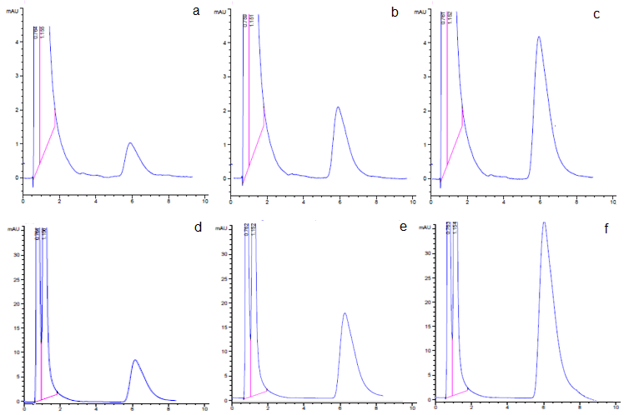
Linearity
Concentration of analyte– absorbance
Calibration curve of metformin in urine
Fig 1. HPLC-UV chromatograms obtained for blank urine spiked with metformin 62.5 µg/ml (a), 125 µg/ml (b), 250 µg/ml (c), 500 µg/ml (c), 1000 µg/ml (d), 2000 $µ$g/ml (f).

Slide 15
Calibration curves
a) b)
Fig 2. Calibration curves of metformin in urine within-day (a) and between days (b).

Slide 16
PRECISION AND ACCURACY WITHIN-DAY AND BETWEEN DAYS
Nominal concentration (µg/ml) | Calculated concentration (µg/ml) | Within-day Mean ± SD (n=6) | Precision % | Accuracy %
QC – L (100) | 97.4 | 97.4 ± 3.811 | 3.9 % | 2.21 %
QC-M (400) | 401.4 | 401.4 ± 20.36 | 5.1 % | 4.25 %
QC-H (1600) | 1666.167 | 1666.167 ± 107.602 | 6.5 % | 1.05 %
Nominal concentration (µg/ml) | Calculated concentration (µg/ml) | Between days Mean ± SD (n=27) | Precision % | Accuracy%
QC – L (100) | 99.8 | 99.8 ± 9.791 | 9.8 % | 0.2 %
QC-M (400) | 396.1 | 396.1 ± 23.73 | 6.0 % | 1 %
QC-H (1600) | 1651.9 | 1651.9 ± 101.916 | 6.2 % | 3.2 %

Slide 17
Limit of Dedection and Limit of Quantification (LOD and LOQ)
LOD = 3.3 SD/S and LOQ = 10 S.D/S, where S.D is LOD = 3.3 SD/S and LOQ = 10 S.D/S, where S.D is the residual standard deviation of regression line and S is the slope of the line.
LOD = 12 µg/ml
LOQ = 35 µg/ml
In the range 62.5-2000 µg/ml

Slide 18
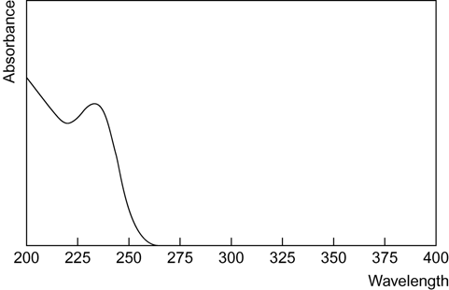
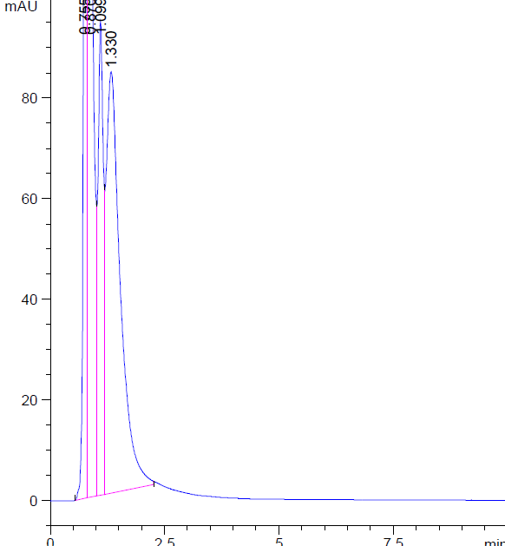
Selectivity and specificity
a)
b)
Fig 3. Spectra of Metformin in 236 nm(a) and HPLC-UV chromatogram of blank human urine (b)

Slide 19
Robustness
Small changes in mobile phase organic strength
and in pH by ± 2% has no significant effect on chromatographic resolution.

Slide 20
Application
The method was used to determined metformin concentration in urine samples from 18 healthy volunteers, after oral administration of a tablet containing 850 mg of metformin.
Fig. 4. HPLC-UV chromatograms obtained for urine from volunteer a- 2 hours (c=1.0931 mg/ml) b- 4 hours (c=1.1813 mg/ml) c- 6 hours (c=0.1356mg/ml) after oral administration of 850 mg metformin tablet

Slide 21
Cumulative amount and rate of excretion
a) b)
Fig 5. Cumulative amount (a) and rate of excretion (b) of Metformin 850 mg tablet in 18 healthy volunteers in 24 hours.

Slide 22
Conclusions
Method was simple,
rapid
selective
accurate
use conventional column
comply the purpose (study of BE from urinary data)

Slide 23
Thank you!

